Slide 1
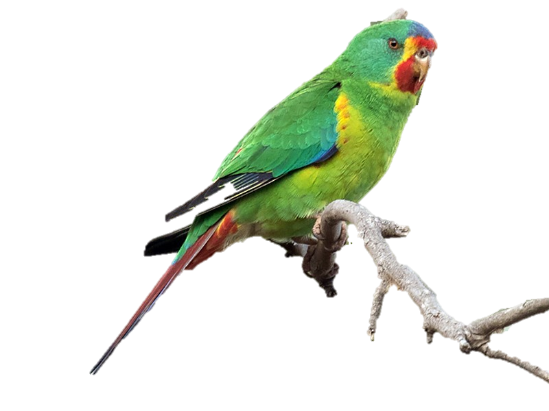
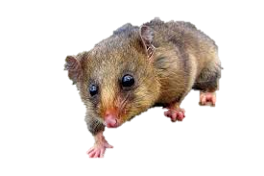
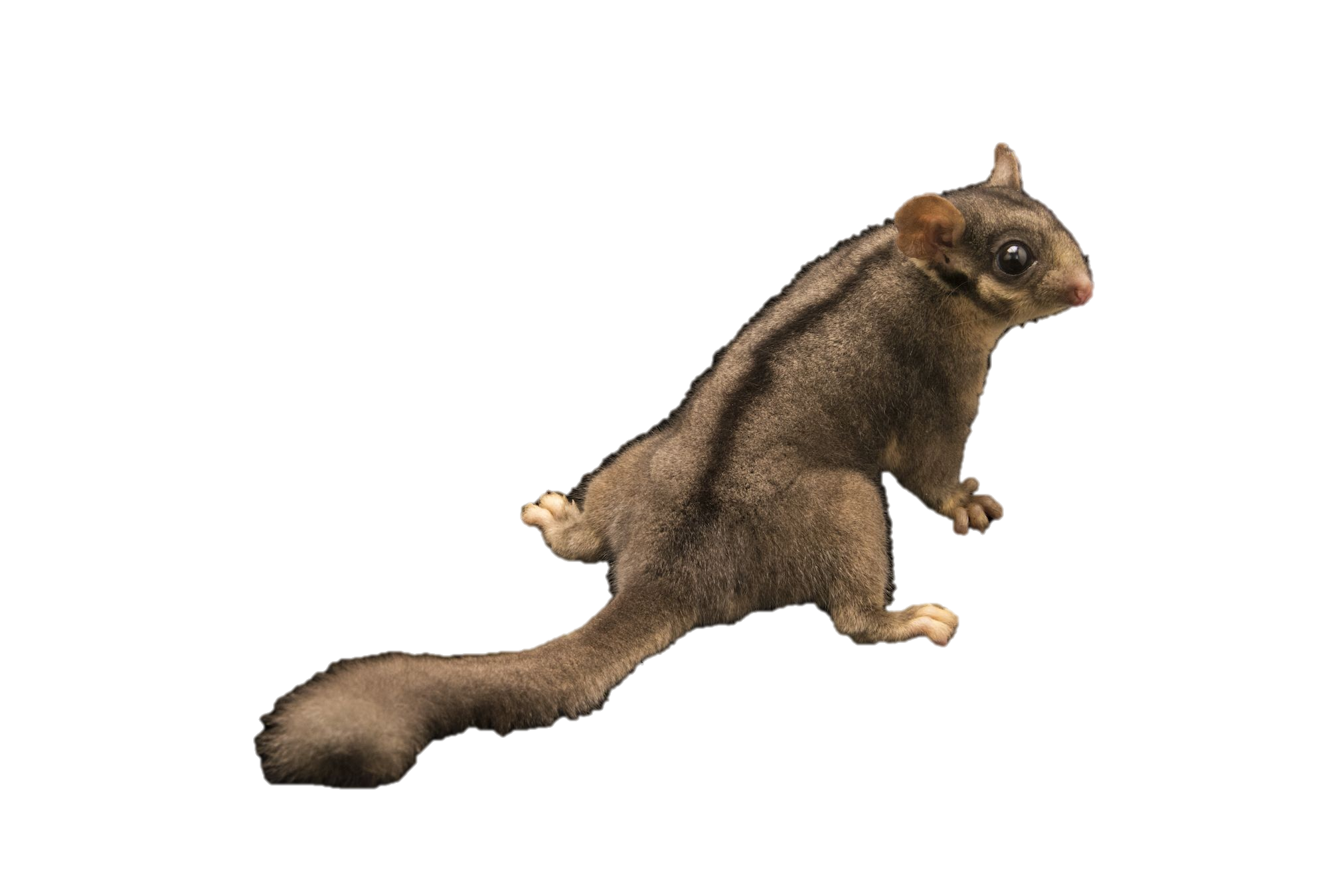
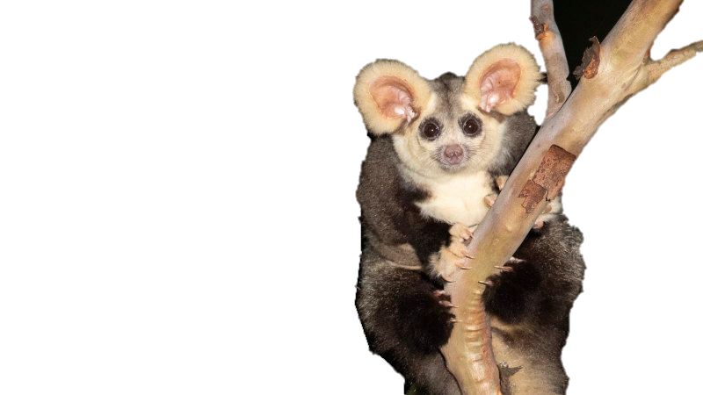
Tracey
the Swift Parrot
Fantastic (and Threatened) Beast$ and Where to Find Them
Kat
the Mountain
Pygmy- Possum
Ruohong
the Leadbeater Possum
Pooja
the Greater Glider
Notes:
Swift parrot – Tracey
Greater glider – Pooja
Leaderbeater’s possum – Ruohong
Pygmy possum - Kat

Slide 2
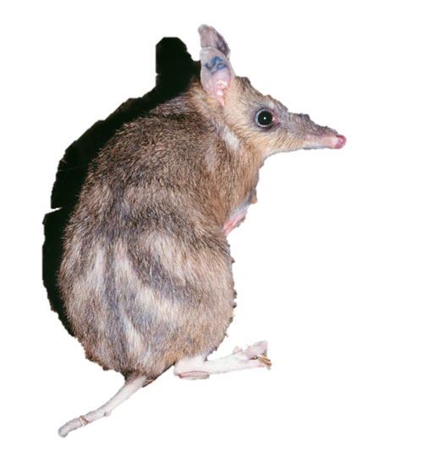
Why fantastic and endangered beast$?
Victoria is home to 12 threatened species of native animals. Some of these are extremely rare to sight in the wild.
The Department of Environment, Land, Water and Planning (DELWP) tracks sightings of these rare animals as part of their conservation efforts. The data is collected and collated into the Victorian Biodiversity Atlas.
With travel restrictions outside of Australia and potentially even interstate, it is a great opportunity for Victorians to explore the great outdoors and go animal spotting.
We wanted to create an easy reference to show explorers where and when they are most likely to sight these rare and fantastic beasts.
Eastern Barred Bandicoot
Notes:
Kat

Slide 3
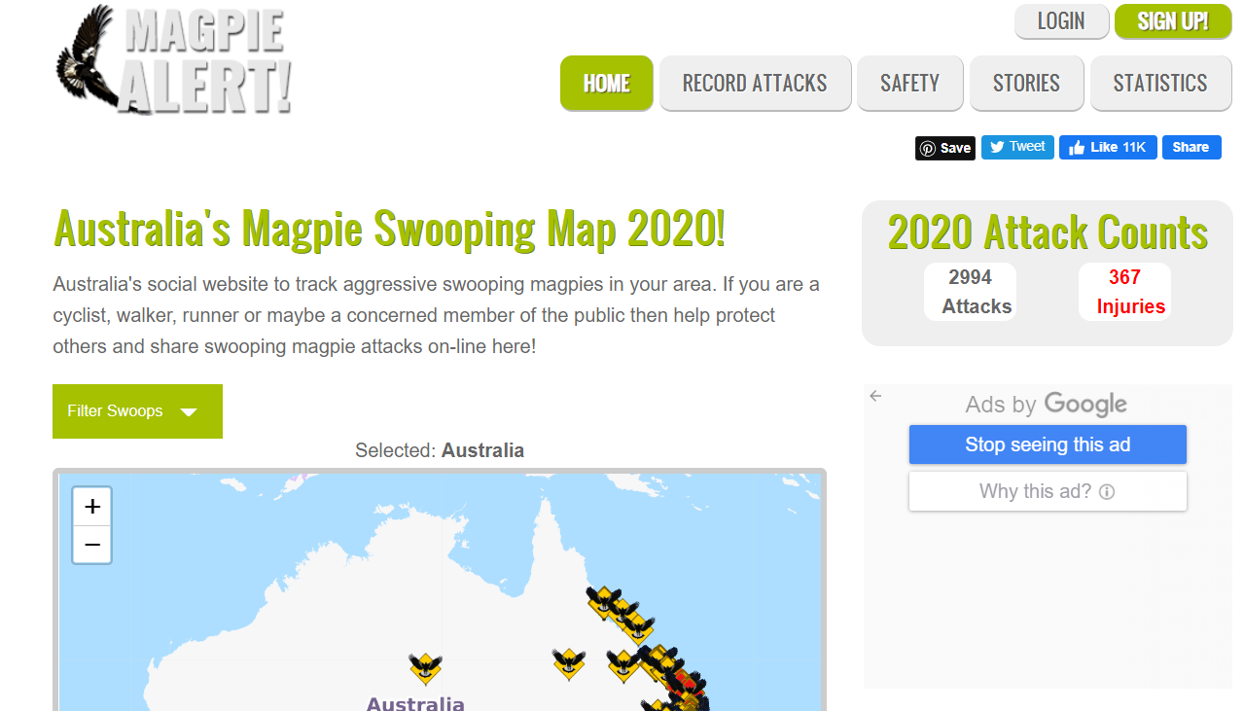
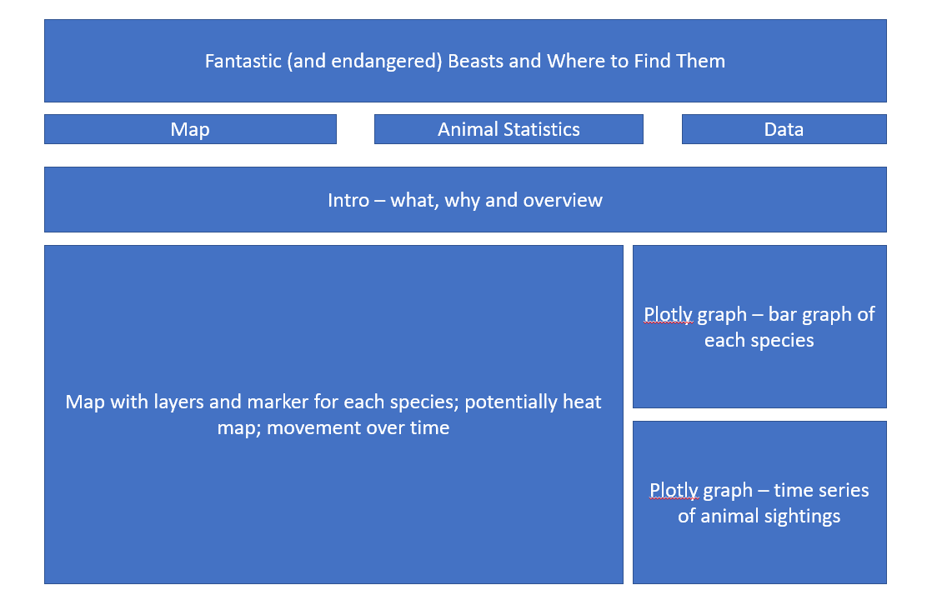
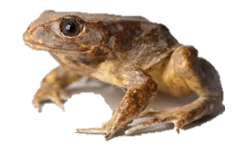
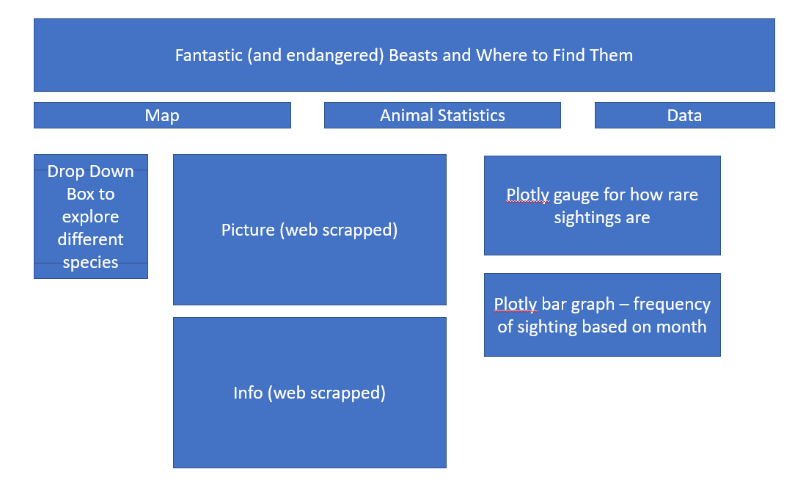
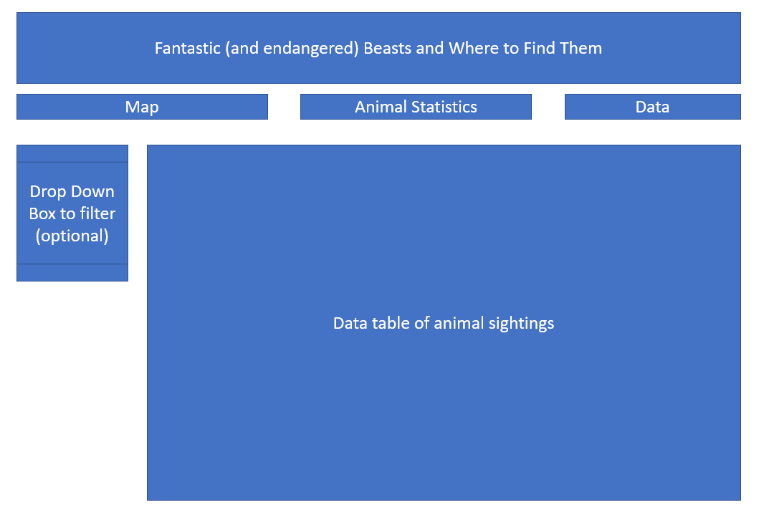
Concept art for fantastic and endangered beast$
In designing our website, we researched similar pages to identify the most user-friendly format to guide animal seekers on their journey.
We were inspired by the Magpie Alert page – https://www.magpiealert.com/
We then developed a sketch of our website with planned visualizations and information to be included.
Baw Baw Frog
Notes:
Kat

Slide 4
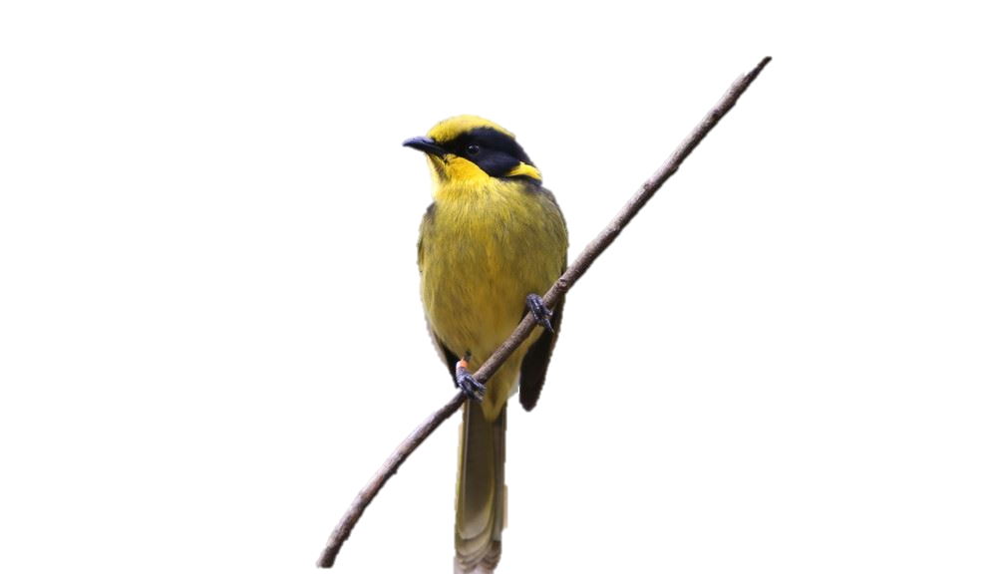
Data sources and where to find them
Data source$ and where to find them
Victorian Biodiversity Atlas
https://services.land.vic.gov.au/SpatialDatamart/dataSearchViewMetadata.html?anzlicId=ANZVI0803004161&extractionProviderId=1
This dataset contains animal sightings for the last 30 years.
Each sighting includes the date, time, location, animal type and the type of sighting.
Local Government Area
https://services.land.vic.gov.au/SpatialDatamart/dataSearchViewMetadata.html?anzlicId=ANZVI0803003519&extractionProviderId=1
This dataset contains information on local government area boundaries.
This could be used to identify municipalities as a map layer.
Zoos Victoria
https://www.zoo.org.au/fighting-extinction/local-threatened-species/
This website provides photos and information on each threatened species.
This could be used to provide information on each animal for the dashboard page.
Parks and Conservation Reserves https://services.land.vic.gov.au/SpatialDatamart/dataSearchViewMetadata.html?anzlicId=ANZVI0803004883&extractionProviderId=1
This dataset contains information on national parks (location and name).
This could be used for a map layer to identify whether a sighting is within a national park.
Helmeted Honeyeater
Notes:
Ruohong

Slide 5
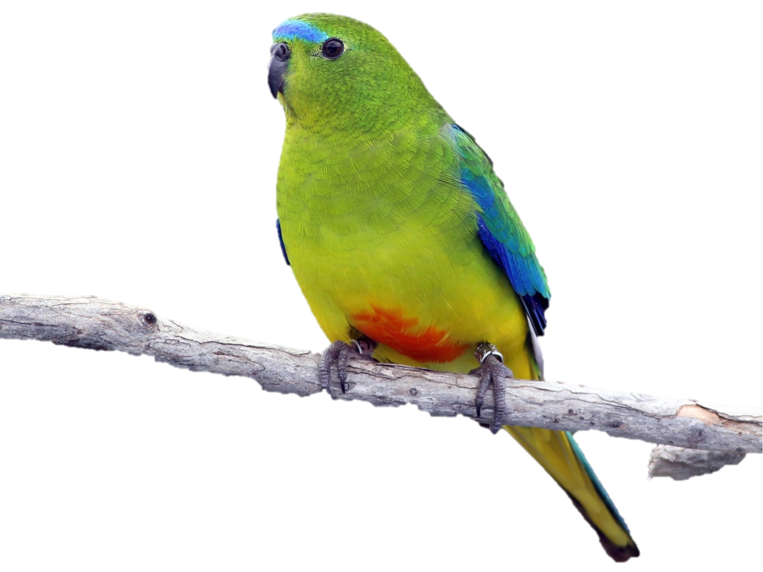
Magical trick$ with data
Cleaning
Loaded data from CSV file into Jupyter Notebook
Transformation
Remove records where the number of animals sighted is 0
Only kept animal records where there is information on the Zoos Victoria website and DELWP website
As the data covers a 30 year time period, we reduced the dataset to the last 5 years for the purposes of guiding animal sighting
Added month and year columns to enable visualization of aggregate values
Cleaned column headers to make it more readable
Checked the data for quality, consistency and any unusual records
Checked the number of unique records for different data fields to understand whether there are any blank records or fields
Reordered columns for usefulness
Web Scraping
Using the Zoos Victoria website (zoo.org.au), we scraped available data on each of the threatened species listed on their website.
From an examination of their website, we were able to identify the photo and some information on each animal to be scraped.
We also scraped the DELWP website for threatened species to cross compare to the Zoos Victoria website.
We only retained the threatened animals which are listed on both sites.
Orange-Bellied Parrot
Notes:
Tracey

Slide 6
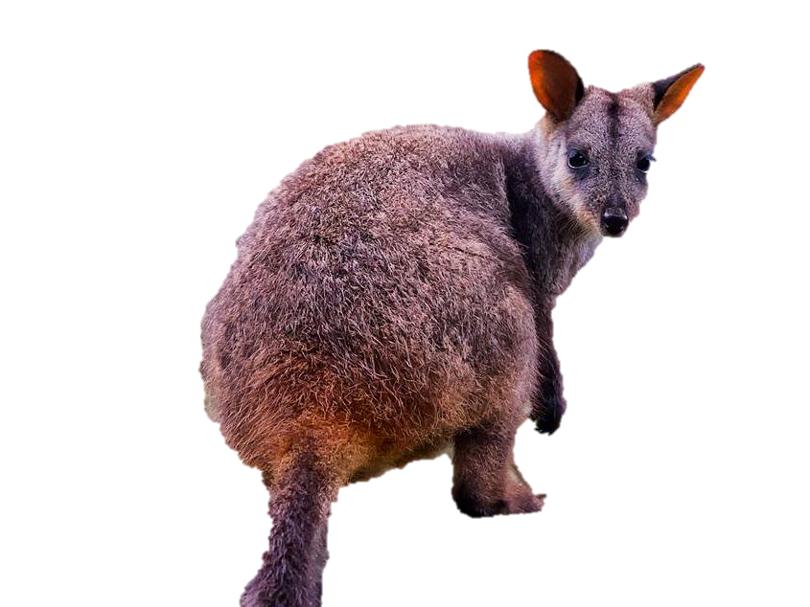
Magical trick$ with data
MongDB
Once the data has been transformed and useful fields for visualization created, we exported the animal sightings data into a CSV for merging with the web scraped data.
We then loaded both datasets into a Mongo Database.
Once loaded, we tested the aggregation to ensure the database has stored the records as expected.
Visualization
In our original plan, we had sketched out a number of visualizations for each page.
Using the Flask data, we started to build our visualizations and adapted them as we identified new or better ways to present our data.
In creating our visualizations, we kept in mind the purpose of the website, what is useful to a user, and what visualization tells the best story with the data.
Flask
We created a Flask API to read in the Mongo database.
Routes were then created for the front end pages (landing page, dashboard page, and data page)
Routes were also created for backend pages to read the underlying data (full dataset, scraped data, aggregation data, and tidied up dataset for the data front end page)
Brush-tailed rock wallaby
Notes:
Tracey

Slide 7
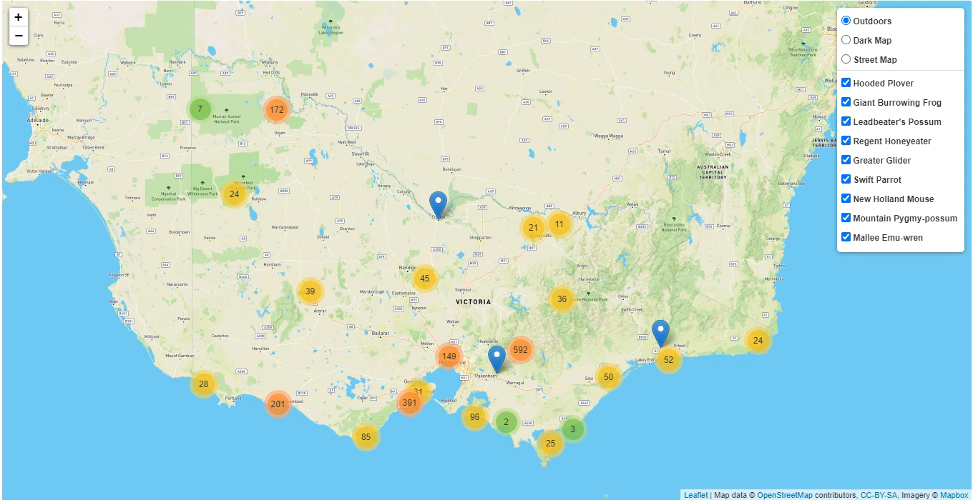
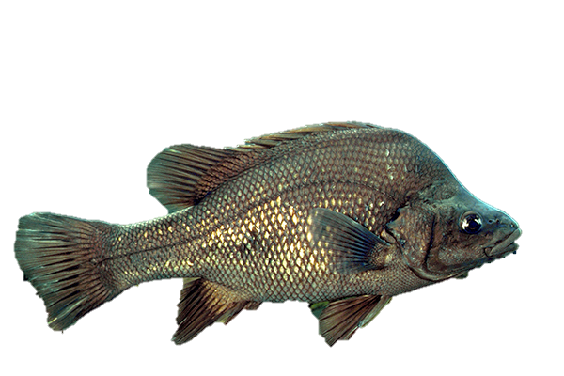
Visuali$ation wizardry (aka Viz Wiz)
Let me show you where to find my threatened friends.. Places which I can’t get to
Macquarie Perch
Notes:
Ruohong

Slide 8
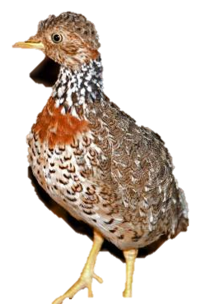
Visuali$ation wizardry (aka Viz Wiz)
With this information, I can stalk all my threatened friends
Plains-Wanderer
Notes:
Pooja

Slide 9
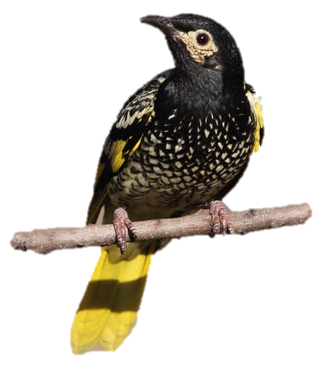
Visuali$ation wizardry (aka Viz Wiz)
For those into the nitty gritty details
Notes:
Kat

Slide 10
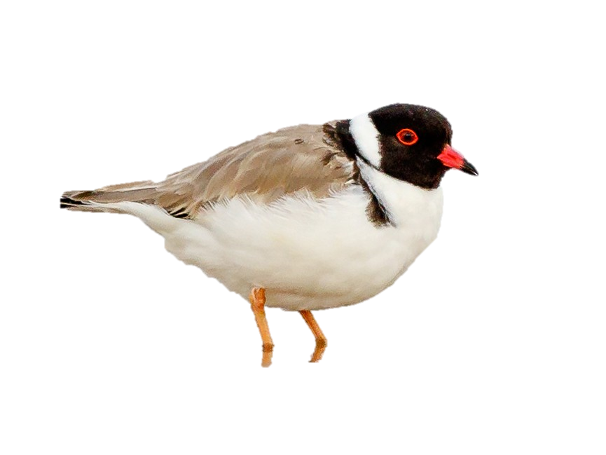
Other world$ to explore
Enhancements
Challenges
Add map layers for local government and national parks
Working with Leaflet, Plotly and d3 is challenging
Add additional threatened animals (expand dataset)
Add scraped information on each animal on dashboarding page
Create a multi-choice filter for the data page
Map layers are not always cooperative!
Creating JSON files is not straightforward
Keeping ourselves on track and continuously redefining our scope to something that is achievable in the timeframe available
Hooded Plover
Notes:
Pooja

